Slide 1
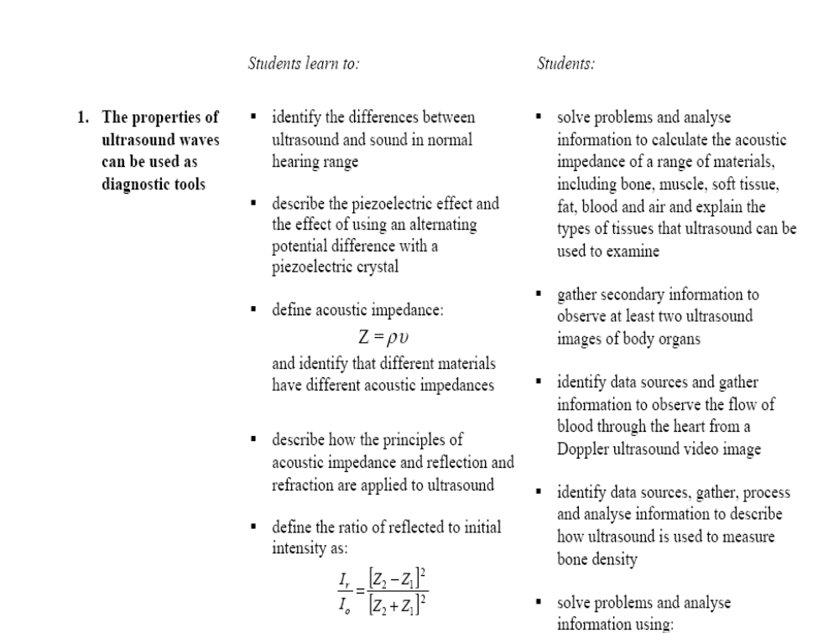

Slide 2
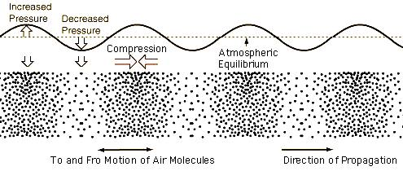
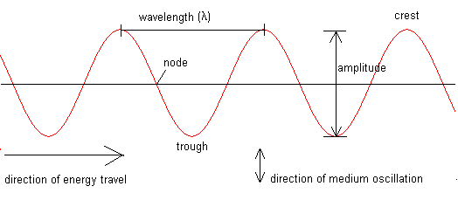
What is an Ultrasound?
It is a sound wave.
Sound waves are longitudinal waves and need a medium in which to travel
The particle of the medium oscillate back and forth in the same direction as the wave travels through the medium.
Wavelength is the distance between successive compressions or rarefactions of the longitudinal wave,
The pressure in the medium is maximum at a compression and minimum at a rarefaction.

Slide 3
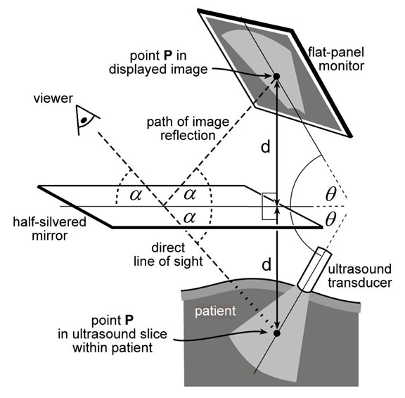
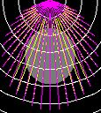
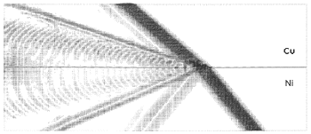
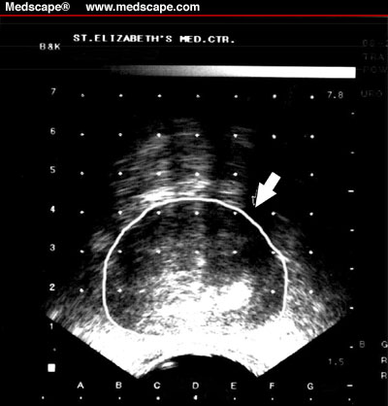
Does an ultrasound wave have the same properties of sound waves? What is it?
Yes
Refraction
Scattering
Reflection
Superimpose

Slide 4
Sound frequency
The sounds that humans are able to hear have frequency between 20 to 20000 Hz.
Ultrasounds have a frequency greater than 20000 Hz and are inaudible.
They usually have a frequency between 1000000 and 20000000 Hz.
Hence, ultrasound waves also have much smaller wavelengths than audible sound waves, of about 1-2mm.
However, both ultrasound and audible sound can be reflected, refracted and absorbed.

Slide 5
The production of an image
In producing an ultrasound image, echoes from two objects close together must be able to be detected.
A sound wave’s ability to produce an image depends on the sounds wave’s wavelength and hence its frequency.
if the separation or size of the objects is less than the wavelength of the sound wave, the objects cannot be detected.
Click here to see the production of an image

Slide 6
What frequency would produce a clear image?
Is it ok to use a very high frequency to produce a detailed image? Justify your answer.
Use page 340-341 to read about it and try to answer this question.

Slide 7
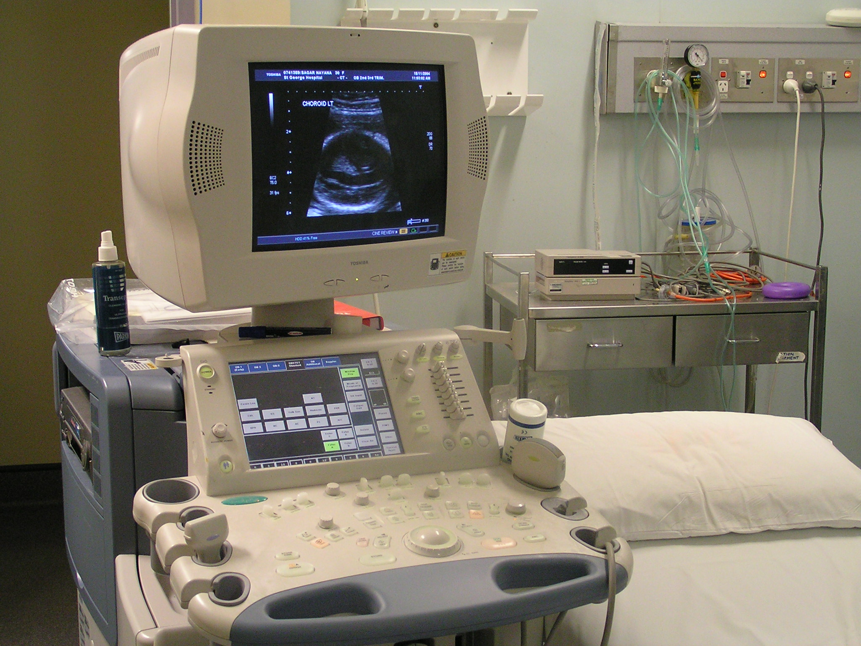
What does the ultrasound machine look like?
Ultrasound has been used as a diagnostic tool since the 1950s, before then it was used to measure distances underwater (sonar) and detecting flaws in metal.
Probably the best known use of ultrasound is to "see" an unborn baby, but it is also used to investigate soft tissue, including breast tissue, for abnormal growths or blockages.
It can also be used to look at blow flow, especially within the heart or to determine bone density.

Slide 8
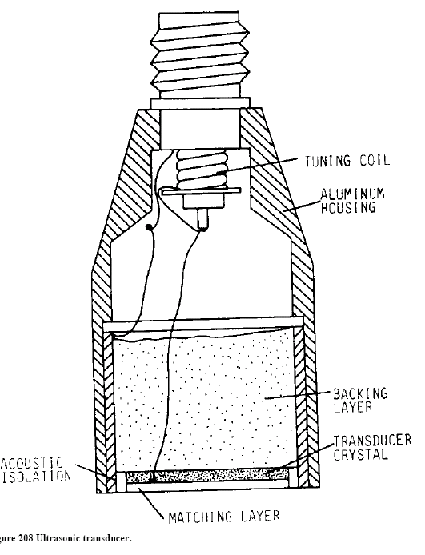
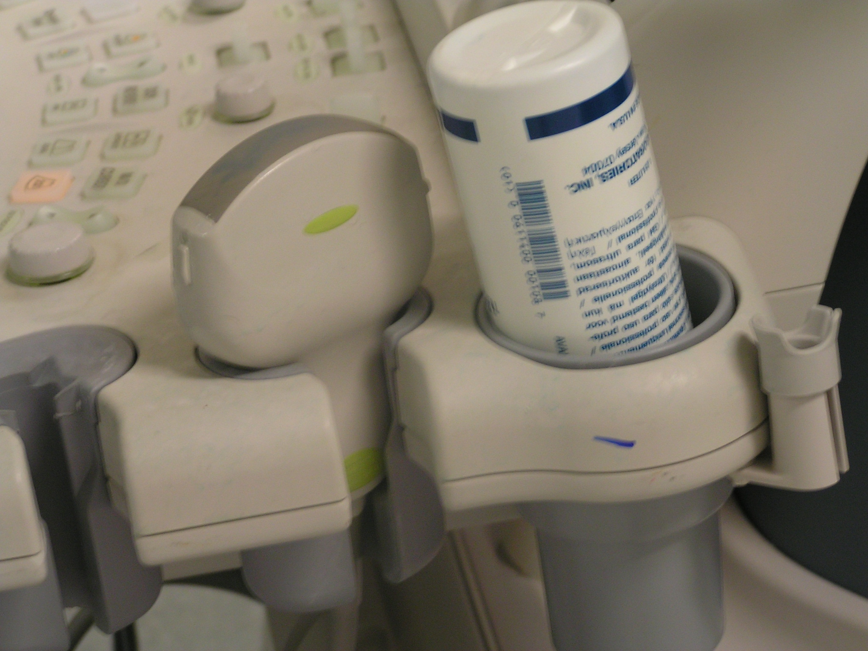
Transducers
Transducers come in a variety of shapes and sizes - the one that is used is determined by what part of the body the scan is going to be of and the type of scan performed.
They all have the same basic components:
transducer crystal (piezoelectric)
backing layer leads
impedance matching layer
housing and tuning coil.

Slide 9
The piezoelectric crystal is sandwiched between a backing layer and an impedance matching layer.
The thickness of the crystal is usually half a wavelength.
The backing layer, absorbs back radiation and provides a coupling to the crystal.
Leads connect the top of the backing layer with the front of the crystal to receive signals or to provide the excitation voltage.
The thickness of the matching layer is an odd number of quarter wavelengths, it also has a mean impedance.
A typical real-time transducer contains over 300 piezoelectric crystals arranged in a row where each emits and receives ultrasound in rapid succession to form a sweep.
About 30 frames a second are produced and a real-time moving picture is formed.

Slide 10
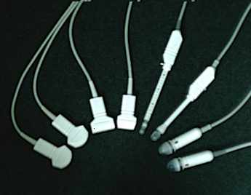
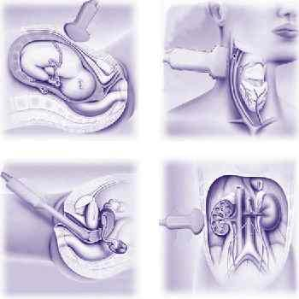
Transducers operate at different frequencies.
The one that is used in any given situation is the highest frequency transducer that can achieve the desired depth of penetration.
Higher frequency ultrasound has a better resolution image but less penetrating ability.
Low frequency ultrasound has better penetrating ability but gives a poor resolution image.
Although a transducer can emit ultrasound, it spends most of the time on the receiving reflected ultrasound.
New technology, focusing and aperture control are employed to narrow the ultrasound beam and increase resolution.
Further beam density and dynamic range control technologies are being incorporated into scanners to optimise the image produced.

